Slide 1


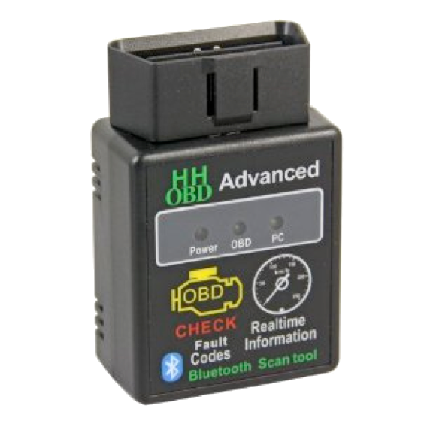
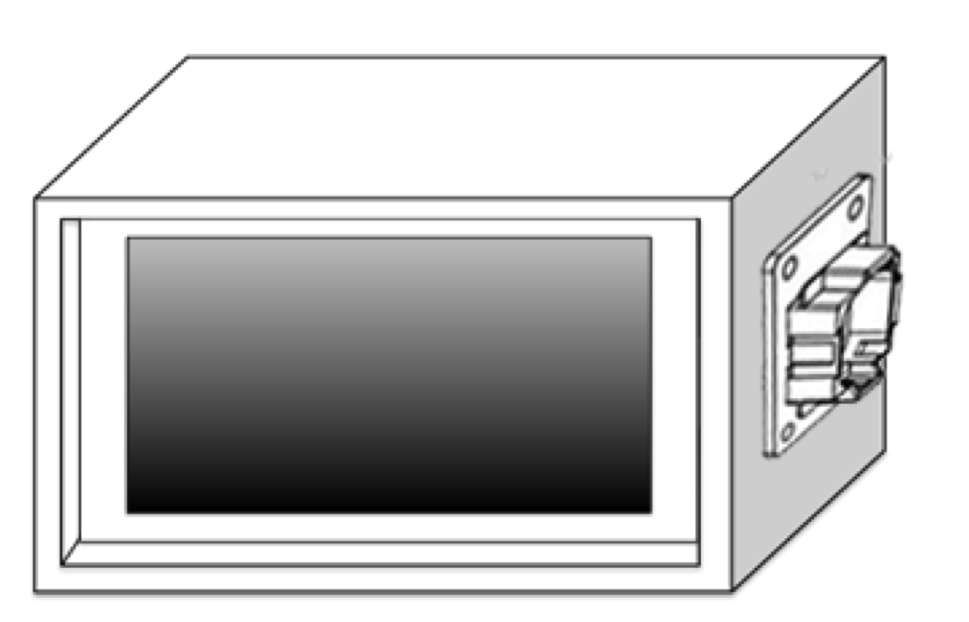
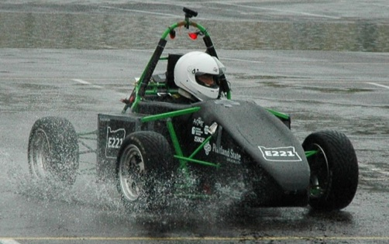
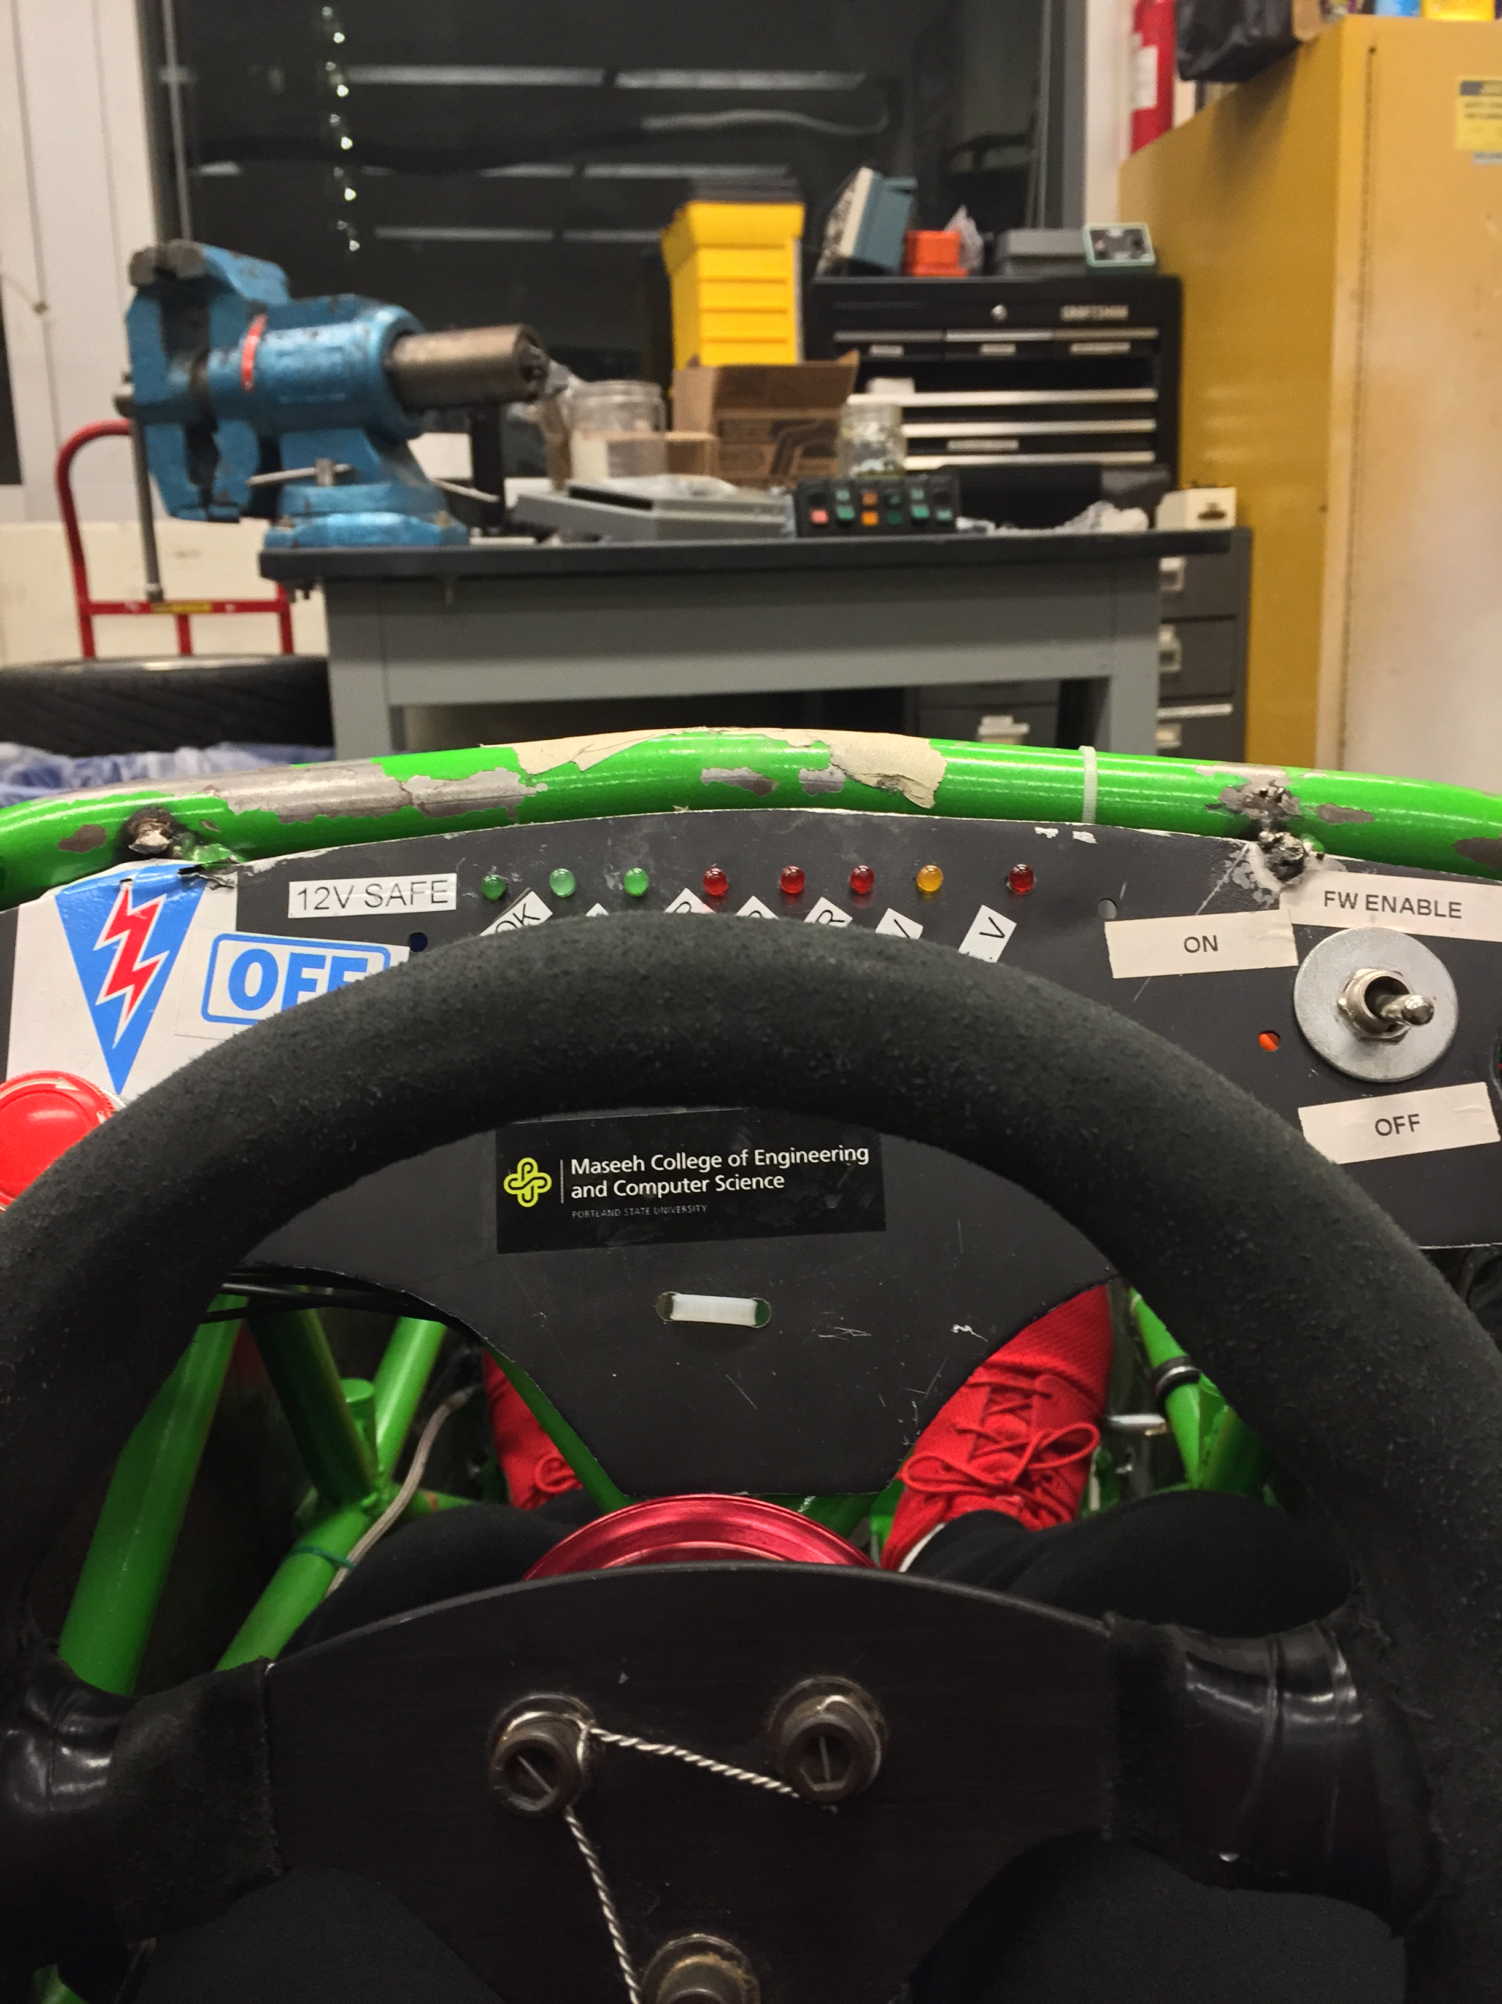
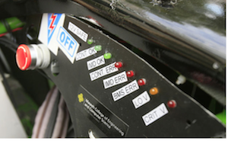
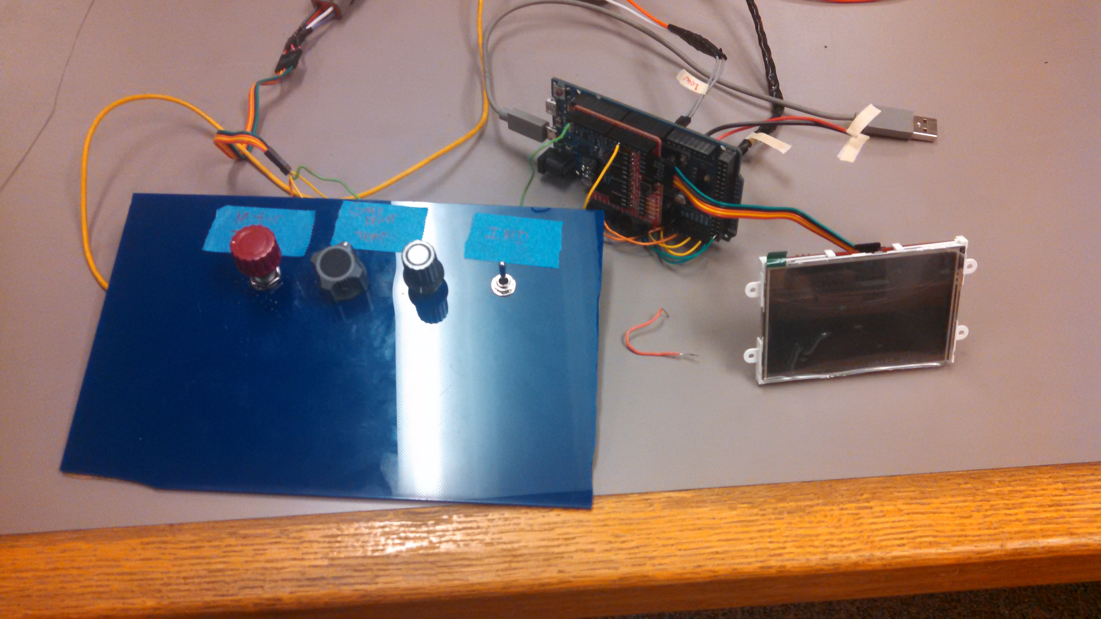
Digital Dash for SAE Electric Race Car
Capstone Team: Noah Erickson, Chad Thueson, Rishal Dass, Jaime Rodriguez, Sean Koppenhafer
Project Sponsor: Michal Podhradsky – Viking Motorsports Team
Capstone Advisor: Dr. Christof Teuscher – Portland State University ECE Department
Prior Work
Implementation
placeholder
In the realm of racing each car is designed completely different based on several factors not limited to driver preferences, resources available and technical limitations. A few popular choices for digital dashboards currently exist. The popular Haltech Racepak is not only expensive, but requires the use of Haltech’s standalone ECU to source the data for the dash. Another setup would be a bluetooth adaptor plugged in to an OBDII port on board the car, but would’ve required the use of the OBDII protocol throughout the design of the car.
CAN Transceivers
Microprocessor
Screen
Placeholder crap
Hardware
LCD Mating
Header
Motivation
The real estate that the digital dash unit took up on the physical dash needed to be minimal. This requirement dictated two large design choices:
The 3.5” Display Size
The custom PCB to cut down size
CAN Inputs
The increased complexity that high voltage systems introduce onto a racecar require increased diagnostics to keep the car running safely. The Viking Motorsports team had previously used a simple bank of LEDs to indicate problems with mission critical systems. Troubleshooting these problems required the car to be off the track and logged data to be analyzed. With the addition of a digital dash system that reads data in real time from the vehicle control unit the driver could be kept up to date on system functionality either on track or in the pit stop.
Further Improvements
The digital dash could be implemented on the internal combustion car
Screen size could be maximized to fit the vehicles dash
The mainboard could be reprinted with the changes made, this would cut down on mod wires, cut traces and test connections
An improved power supply could be implemented to cut down on power consumption and compatibility with a 12V system.
The enclosure could incorporate a cowl in order to improve readability in direct sunlight
The entire system was first prototyped using an Arduino Due which was slightly too large for the solution we had in mind.
The screen was smaller than the Arduino Due and there would have been a lot of wires plugging into the screen. We wanted our device to be as plug-and-play as possible so we created a custom PCB that would plug directly into the LCD with no “mod wires”.
Programming Circuit
12V Supply
Software
Conclusions
Solution
The software portion of the digital dash was created using the Arduino IDE. In order to interface with the CAN bus and the 4D systems screen the use of two separate Arduino libraries were used. The software reads the CAN bus looking for pertinent messages (hardcoded by the user), interprets them, and sends the data to the screen.
The digital dash performs as designed under the operation of the demo unit that was created. The potentiometers send analog inputs to the eVCU to simulate values that the car would get from different components on the vehicle. The eVCU then translates these values into CAN messages and sends them to the digital dash.
Three major requirements were addressed when designing the digital dash. The first two dictate the microprocessor which must support multiple communication protocols and be fast enough to handle receiving messages on a CAN bus. The 32bit 84MHZ ATSAM3X microprocessor, the same that an Arduino Due uses, fit the bill. This also allowed the design team to use an Arduino Due to get to prototyping faster. The next large decision was the screen used because it needed a high resolution to draw gauges and display information while also having a compact size. We chose a 3.5” LCD from 4D Systems.
Another large requirement for this project was that it was open source and easily reproducable. To support this we chose to host our project on Github and post a massive amount of documentation to aide other universities racing teams in the process of creating a digital dash.
Screen
The 4D Systems screen came with a useful piece of software to aide the quick creation of GUIs. The GUI was created to be simple and intuitive and also utilizes the resistive touch capability of the screen in order to flip through a couple different submenus that include further information that a driver might want. The screen receives data from the mainboard through a serial connection and changes the corresponding gauges
Due to circumstances outside our control the digital dash has not been tested on the electric vehicle itself.
Acknowledgements
Special thanks to Quinn Sullivan for being the guy

